Slide 1





SMART INDIA HACKATHON 2020
Ministry name: Ministry of power
Problem statement no: LN382
College Name: Prince shri venkateshwara
padmavathy engineering
college

Slide 2
DETAILS
Techno wizard
Team members
S R VIKNESH
YOGESWARI
VARSHAA
A JOHN SAMUEL
A JOEL HENDRY
K MERVEEN JACOB
Mentors
Dr.P Kaplavani PhD, Associate Professor
Department of Information Technology
Dr. Senthil Kumar PhD, Associate Professor
Department of Electronics and Communication Engineering

Slide 3
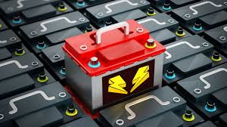
PROBLEM STATEMENT
In line with the Government of India's vision of 30% e-mobility by 2030, the National E-Mobility Programme was launched in India in March, 2018. Under this program , electric vehicles (EVs) are being procured by EESL and leased out to government organizations at rentals that are equal to the present rentals for petrol and diesel cars hired by these organizations. Battery is critical component of EV which is the fuel who runs Electric vehicle and hence it is imperative to monitor the battery life and predict about it maintenance, charge and give enhanced enriched user experience which not only save energy costs but also improve the standard of living
Monitoring car battery

Slide 4

Statement explanation
Step towards era of clean, green and future oriented technologies in the country.
Will be implemented by energy efficiency service limited (EESL)
To provide electrical start to engine
Main component in Electrical Vehicle
So it is necessary maintain battery in EV

Slide 5
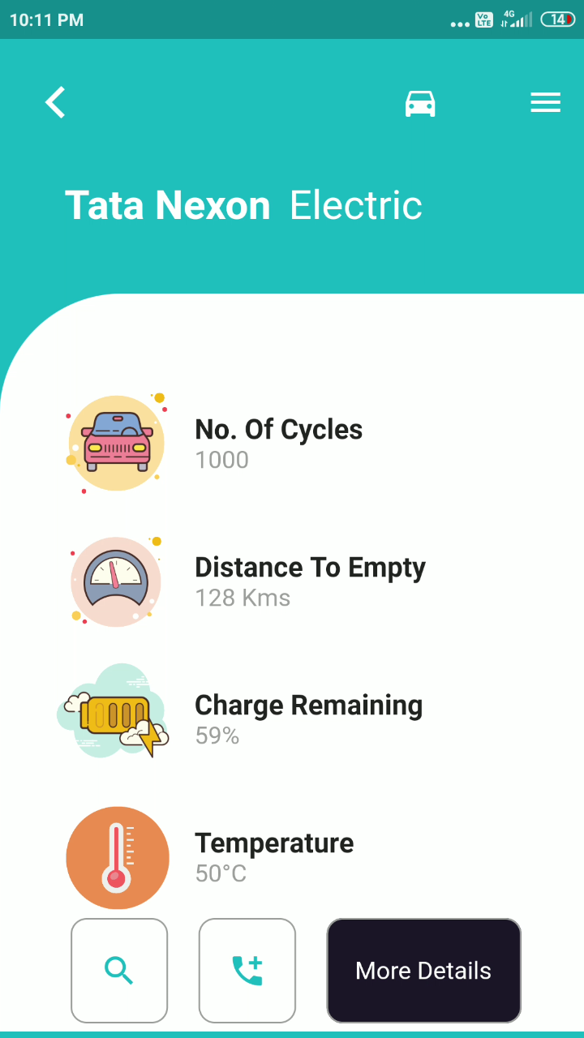
Electric vehicles
1.3lakh units of vehicles very sold in previous years and it raised to 1.56 lakh unit in last 2019-2020
Reasons why people change EV:
Cheap to run and maintain
Better for environment
Energy security
Health improvements
Safety improvements

Slide 6
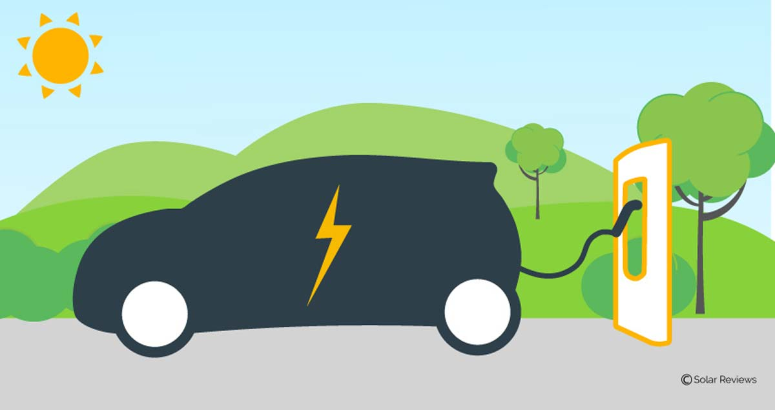
DIFFICULTIES
According to National E-mobility Programme, the cars will be given in rotational manner to the customers .
So it becomes difficult for the authority to monitor the battery condition of 1000’s of vehicles every time.
It becomes difficult to communicate the exact customer to inform the battery draining condition.

Slide 7

solution
It becomes easy when everything is controlled and monitored in our hand.
So the app which monitors the all car batteries with proper data base will be helpful for the authority to overcome the problem.
The app should track the vehicle, monitor battery level in our car and should give an alert system to user as well as to authority when it reaches the minimum value.

Slide 8
Working of our product
Personalized login for a particular user.
Entire data base and car condition for authority.
Parameters calculated are: battery remaining, temperature distance travelled by the battery and distance that can be travelled with the remaining battery amount, location of the vehicle

Slide 9


Data transfer flow
Easy and secured communication between the hardware and the software
Battery and other module
cloud
Mobile app

Slide 10



Mobile app
Fast source code editor, support for multiple languages, easy to edit code
Edit ,build, debug with ease.
Strong library support
Simple ,scalable, stable
Fast , efficient and easy method of coding
Integrate and control many things

Slide 11
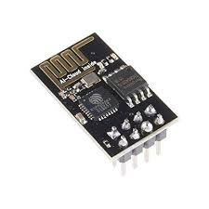
Harware
We don’t need much change in hardware , a battery with a Wi-Fi module and processor to transmit data to the cloud.
Data could be transmitted using this Wi-Fi module to the cloud
ESP 8266 Wi-Fi module cheapest and reliable module.

Slide 12
replica
315mi- most efficient EV has 315 miles of range on a single charge
Reach your destination of 158 miles in 15 minutes.
Delivers a high range of battery life compared to other EV due to change in battery chemistry

Slide 13
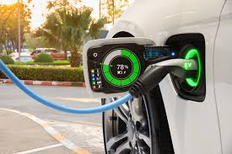
conclusion
As a whole we can extend battery life by continuous monitoring and proper maintenance with our product.
This will reduce the people work towards battery frequent monitoring.
The detailed explanation of the setup is given in next PowerPoint.
Thank you!

